Slide 1
Cell Membrane Transport: Active Transport (part 2 of 2)
Lecture 11

Slide 2
Objectives 1 of 2
Understand/know/focus on/note
what a resting membrane voltage is, how it is generated in all cells by the pumping and transport of ions across cell membranes
how both a chemical potential (chemical concentration difference) creates an electrical potential (voltage) across a cell membrane
how an action potential in excitable cells is made possible by the resting membrane potential and the movement of ions across the membrane
how the action potential radiates over the surface of a membrane to create the nerve impulse

Slide 3
Objectives 2 of 2
Understand/know/focus on/note
the importance of the Na/K pump in secondary (coupled) transport, with Na/glucose and Na/Ca transporters as examples
the role of calcium in the cell and why calcium regulation depends on the Na/K pump
diseases and disorders that can be observed clinically that are related ultimately to poor function of the Na/K pump

Slide 4
Chemical Potentials
Suppose there are 100 Na⁺ on the extracellular side of a plasma membrane and 50 Na⁺ ions on the intracellular side: this is a concentration difference…a chemical potential
If we put a hole in the membrane, eventually there will be an equilibrium of 75 Na⁺ ions on each side of the membrane (an even dispersal)
Instead of a hole, we can use the chemical potential as a form of energy to do work, like moving ions or molecules in coupled transport

Slide 5
Electrical Potentials (Voltages)
Suppose on the outside of the cell the following ion counts: 150 Na⁺, 5 K⁺, 125 Cl– ions
Suppose on the inside of the cell the following ion counts: 15 Na⁺, 150 K⁺, 9 Cl–, and 200 negatively charged ions on proteins
Adding up the net count of charges on both sides of the cell membrane, there are more positive charges on the outside relative to positive charges on the inside (or more actual negative charges), so that makes the membrane + on the outside and – on the inside

Slide 6
Two Potentials (Two Forces)
With the concentration differences of specific ions, we have a chemical potential
With an accounting of all the ions, positive and negative, across the membrane, we have net positive charges outside, and net negative charges inside: an electrical potential (voltage)
Na⁺, K⁺, and Cl– ions will want to equalize their concentrations if there channels are opened
proteins are too big and kept in cells, but their contribution to the ionic charge count is still part of how the electrical potential is formed

Slide 7
"Resting" Membrane Potential
This refers to the electrical potential (voltage) across the membrane
It is generated by the Na/K pump and ion cotransporters discussed, with ATP energy used to drive the concentration differences that create the voltage
The resting membrane potential exist in all cells
The electrical potential is a form of energy that can be exploited to do transport processes across the membrane, or which might be used in other energy-requiring metabolic processes
In numbers: potential = –70 millivolts (mV)

Slide 8
Competing Forces
Consider the case of the neuron
Na⁺, K⁺, Cl– concentration differences created across the plasma membrane
K⁺ ion channel is kept open in the membrane
K⁺ concentration is greater inside the cell than outside, so K⁺ should rush out of the ion channel if it is kept open (rush out = diffusion)
chemical potential or "chemical force"
But the membrane voltage has a higher net negative charge inside the cell: this electrical potential ("electrical force") keeps the K⁺ ions from rushing out and holds K⁺ ions inside the cell

Slide 9
Action Potentials
For "excitable cells" (neurons), they have a special property that creates a "wave" of momentary alternating voltages along the plane of the cell membrane that is the nerve impulse
Stimulus. The membrane must first be "perturbed" or "stimulated."
How this occurs is not important. It might be achieved be the release of a chemical neurotransmitter from a neuron connecting with the neuron focused on here: that transmitter is a ligand that binds a receptor which acts an ion channel for the next step
Na⁺ ions. The stimulus causes some Na⁺ ion channels to open
Since there are more Na⁺ ions on the outside than inside, combined with the resting membrane voltage that is more negative inside than outside, the Na⁺ ions rush into the cell through the now open Na⁺ channel proteins

Slide 10
Action Potentials: The Steps
Reaching A Threshold. The difference in the membrane voltage decreases a little with Na⁺ ions rushing in. At a certain voltage difference—a threshold—another set of Na⁺ ion channels open
these are voltage-sensitive ("voltage-gated") Na⁺ ion channels
Depolarization. A massive influx of Na⁺ occurs with even more Na⁺ channels open. Now the membrane is more electrically positive inside than outside. The process of this decrease in the difference of membrane voltage is called depolarization.

Slide 11
Action Potentials: The Steps
K⁺ ion outflow/stopping Na⁺ inflow. With change in membrane polarity, the K⁺ ions now rush out of the cell. The inflow of Na⁺ ion is halted too.
This occurs because K⁺ ion channel proteins are sensitive to the change in voltage across the membrane caused by the inflow of Na⁺, so these voltage-sensitive ("voltage-gated") K⁺ channel proteins now open. The outflow of K+ ion is favored for two reasons:
intracellular K⁺ concentration was higher than the extracellular concentration, so K⁺ ions move with their chemical potential
the reverse in polarity to make the inside more positive favors any positively charged ion flowing out according to the electrical potential
Na⁺ inflow stops because the voltage-gated channels close at the peak of the depolarizing voltage

Slide 12
Action Potentials: The Steps
Repolarization. With K⁺ ions moving favorably with the force of both a chemical and electrical potential, the result is there are more positive charges now outside the cell than inside. The membrane changes polarity again in an event called repolarization. The voltage-sensitive K+ ions will close
there is a transient period where K⁺ ion outflow causes the inside of the membrane to be more negative than it usually is in the resting potential (this is called hyperpolarization), but it restores to the resting potential quickly
Recovery. Cells must re-establish Na⁺ and K⁺ concentrations on both sides of membrane to restore the resting potential. That's why the Na/K pump works at a high capacity, particularly in neurons

Slide 13
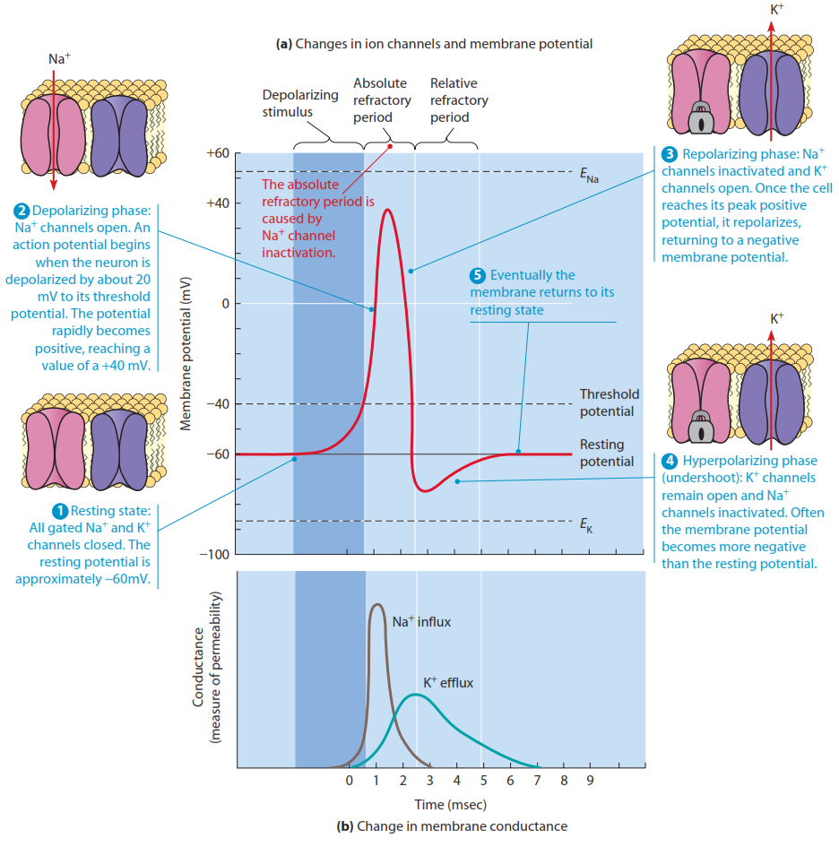
Two plots show the changes in membrane voltage and conductance (flow) of Na⁺ and K⁺ versus time that are involved in the depolarization and repolarization phases of the action potential
see p 376 in Becker

Slide 14
The Nerve Impulse
The Wave
Na⁺ channels opening and Na⁺ rushing in (depolarization) and K⁺ ions rushing out (repolarization) radiates outward from the point of stimulus along the membrane
It appears as a wave of alternating voltage down the plane of the membrane, a description of the nerve impulse
In another part of the neuron (axon terminals), the electrical changes on the membrane would cause Ca²⁺ channels to be opened that cause vesicles to fuse with a membrane to release their contents

Slide 15
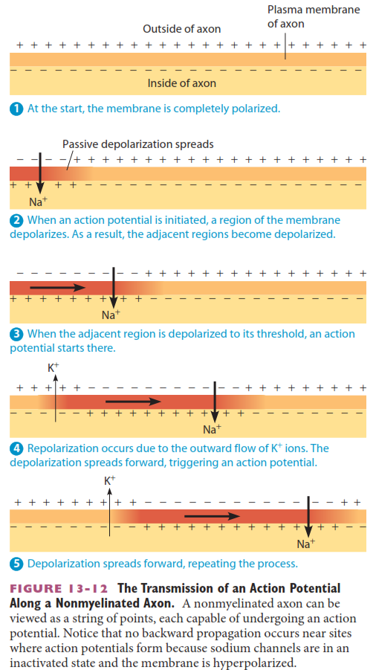
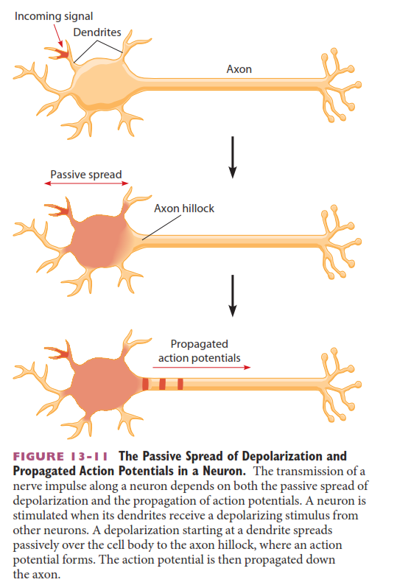
The wave of the action potential moving in the plane of the membrane is the nerve impulse (at right)

Slide 16
Terms / Definitions
antiporter
used to describe membrane transport proteins that use coupled (secondary) ATP transport to move two substances in opposite directions across the plasma membrane
the chemical potential (concentration difference) of one substance is the energy driving the transport
symporter
used to describe membrane transport proteins that use coupled (secondary) ATP transport to move two substances in the same direction across the plasma membrane
again the chemical potential (concentration difference) of one substance is the energy driving the transport

Slide 17
Na⁺/Glucose Coupled Transport
Cells in the intestine and kidney have membrane proteins that couple the high [Na⁺] on the outside of the cell to co-transport of glucose into the cell
The cells in the kidney are the epithelial cells forming the proximal convoluted tubule
As Na⁺ moves into the cell according to its chemical potential, it uses the energy in that potential to bring in glucose molecules across the membrane protein with it.
chemical potential refers to the concentration difference of a substance across the membrane, and the force involved to equalize concentration across membrane
Ratio: one (1) Na⁺ ion with one (1) glucose molecule

Slide 18
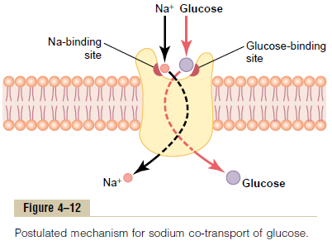
Na⁺/Glucose Co-Transporters
This moves glucose against, not with, its concentration difference across the membrane
The Na⁺/glucose symporter described here is NOT the glucose transporter discussed earlier: that works by facilitated diffusion, and does not need cell energy to move it across the membrane
1 Na⁺ with 1 glucose
Note that Na⁺ and glucose bind to special sites on the cell outside, then are moved in

Slide 19
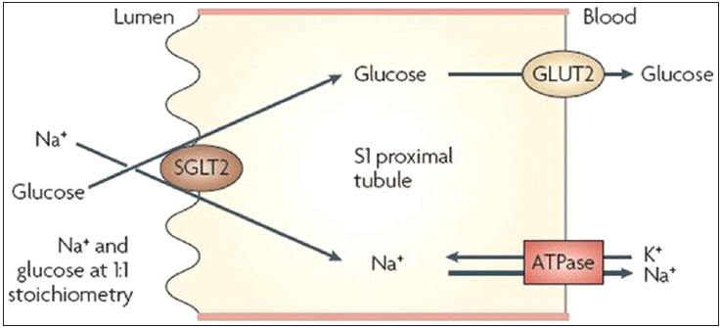
In Context
The figure below shows how the Na⁺/glucose co-transporter (identified as SGLT2) works to move glucose from the relative outside of the body to the inside
SGLT2 = sodium/glucose transporter #2
As glucose accumulates in the cell, it will pass to the outside of the cell by facilitated transport (high->low concentration)
through the membrane protein identified as glucose transporter 2
The high Na⁺ ion concentration on the outside of the cell must be generated again by the Na/K pump

Slide 20
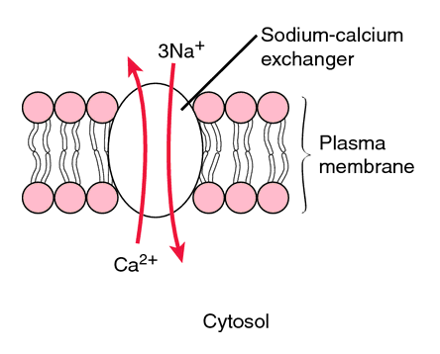
Na⁺/Ca²⁺ Coupled Transport
This is no different than the Na⁺/glucose coupled transport system in that the concentration difference of Na⁺ is the energy used to drive the transport of something
Differences
This is an antiporter: substances move in opposing directions
Ratio: 3 Na⁺ ions must move across to transport 1 Ca²⁺
glucose was not ionized, but Ca²⁺ has twice charge of Na⁺ (so maybe move two Na⁺ ions to electrically balance one Ca²⁺ plus the gondolier's coin of one Na⁺ for the transport [?])

Slide 21
Clinical Significance of Na/K Pump
Dietary Magnesium (Mg²⁺)
Fischer & Gioux (1987) reported that diets deficient in magnesium could affect the Na/K pumping rate, decreasing it, with the effect of cause heart arrhythmias.
6 in 10 Americans are said to be Mg²⁺-deficient because of a poor diet lacking in
green leafy vegetables
whole seeds and grains

Slide 22
Hypertension & The Na/K Pump
Diabetes & Hypertension
Na/K pump activity is appears to be reduced by 40% in diabetics and those with hypertension
Circular smooth muscle forms rings around arteries and its smaller vessels
If the smooth muscle of arteries and its smaller vessels contracts throughout the body, this increases blood pressure
All muscle contraction depends on Ca²⁺ flowing into the muscle cell; relaxation depends on Ca²⁺ being pumped out
Ca2+ is pumped out by the Na/Ca exchange pump, and that depends on the Na/K pump working
High salt diets are reported to strain the Na/K pump
Hence a link between high salt diets & hypertension may exist

Slide 23
Effects of Calcium Imbalances
Calcium is kept at low levels inside the cell, and is constantly being pumped out of the cell by the Na/Ca exchanger, which depends on the Na/K pump
At high levels, calcium binds to many proteins (particularly enzymes or activators of enzymes) which cause changes in cell function, similar to the changes discussed in cell signaling
In muscle cells, it causes muscle contraction when intracellular Ca levels increase
in cells that secrete a hormone or chemical, it causes the fusion of the membranes of storage vesicles that hold the chemical/hormone with the plasma membranes, releasing the chemical/hormone (exocytosis: to be discussed in detail)

Slide 24
Diabetes & Calcium
Insulin is produced in the beta cells formed in islands in the pancreas and stored in membrane-bound vesicles
Insulin is released from vesicles when intracellular Ca²⁺ levels are increased by signals that trigger opening of Ca²⁺ channels, and this causes the vesicle membranes to fuse with the plasma membranes, releasing insulin into the blood
If Ca²⁺ levels do not remain low because of failures in the Na/Ca exchange protein, which might be caused by Na/K pump dysfunction, then insulin could be continually secreted, leading to hyperinsulinema (high levels of insulin in blood)
This eventually leads to a resistance to insulin response (caused by a reduction in insulin receptors)
Cells do not respond to insulin and take up glucose, leading to diabetes & an associated cardiovascular disease

Slide 25
Things To Look At
Animation of Resting Membrane Potential
http://bcs.whfreeman.com/thelifewire/content/chp44/4401s.swf
Animation of Action Potential
http://bcs.whfreeman.com/thelifewire/content/chp44/4402s.swf
Other animations
http://outreach.mcb.harvard.edu/animations/actionpotential_short.swf
http://www.sumanasinc.com/webcontent/animations/content/action_potential.html
http://highered.mheducation.com/sites/0072495855/student_view0/chapter14/animation__the_nerve_impulse.html

Slide 26
Reading (Sources)
Becker's WotC: pp 364-369, 372, 375-379
Raven: pp 890-894

